Slide 1
Potential Outcomes and DAGs
Week 3 — QMSS 75000 / SOC 81900
From confounders and colliders to ATE and ATT
Edwin Grimsley, Ph.D.

Slide 2
TONIGHT
Agenda
1
Quick Refresher
Confounders, mediators, colliders — recap from Week 2
2
Reading and Building DAGs
The Dagitty.net interface, and what adjustment sets actually are
3
Potential Outcomes
The fundamental problem of causal inference, formalized
4
ATE, ATT, and ATU
Why they're different numbers, and when each one is what you want
5
This Week's Lab & Homework
What you'll build in Dagitty and in R

Slide 3
PART 1
Quick Refresher: Controls

Slide 4
REFRESHER
Confounders: The Good Control
W (confounder)
W causes both X and Y — that's what makes it a confounder.
Skip it, and its effect leaks into your treatment estimate.
Control for it, and you recover the true effect (Lab 1, Scenario A: 1.29 without W, 1.00 with it).
X (treatment)
Y (outcome)

Slide 5
REFRESHER
Colliders: The Bad Control
X (treatment)
Y (outcome)
Z is caused by BOTH X and Y — arrows point IN, not out. Opposite structure from a confounder.
Controlling for it OPENS a spurious path that didn't exist before.
Lab 1, Scenario B: a correct estimate (1.00) got worse (0.62) once we added the collider.
Z (collider)

Slide 6
REFRESHER
Mediators and the Question We Ask
M (mediator)
X (treatment)
Y (outcome)
A mediator lies on a causal path from treatment to outcome: X → M → Y.
For the total effect, keep the path through M open. Do not adjust for M.
If the question is how X works through M, draw M and study that pathway explicitly.
Adjusting for M alone does not automatically identify a direct effect; that needs more assumptions.

Slide 7
REFRESHER
One-Slide Summary
Confounder
Causes both X and Y
Control for it
Collider
Caused by both X and Y
Avoid opening its path
Mediator
Caused by X, causes Y
Keep open for total effect

Slide 8
PART 2
Reading and Building DAGs

Slide 9
DAGS
Directed Acyclic Graph — a picture of your causal assumptions, not your data.
Nodes = variables. Arrows = direct causal effects (not mediated by anything else in the diagram).
“Acyclic” means no loops — arrows follow time order, causes come before effects.
Drawing one forces you to be explicit about assumptions you'd otherwise leave implicit — that's the whole value, even before you calculate anything.
What Is a DAG?
Omitting an arrow is a STRONGER claim than including one — it says “I'm confident this cause doesn't exist,” not just “I didn't think about it.”

Slide 10
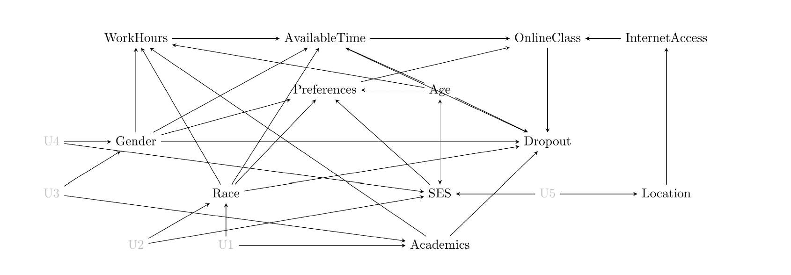
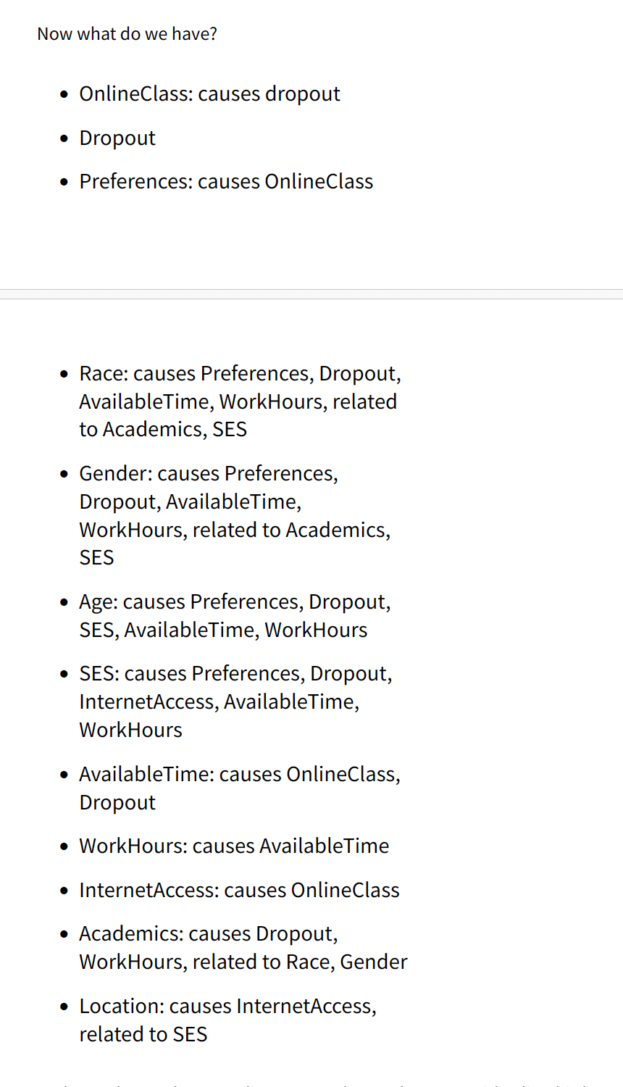
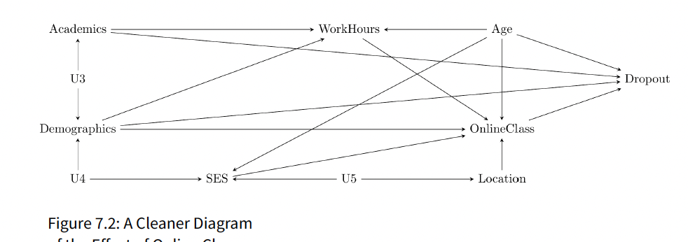

Slide 11
Start with the question: Does taking an online class affect dropout?
The book builds a crowded diagram from causes of online class use and dropout.
It then removes an intermediate step when the mechanism is outside the question.
THE EFFECT, CH. 7
Online Classes and Dropout: Simplify the DAG
Keep a mediator visible when the research question asks how the effect occurs.

Slide 12
Causal path: X → M → Y. Keep it open when estimating the total effect.
Backdoor path: X ← W → Y. Adjust for W to close this source of bias.
Collider path: X → Z ← Y. It starts closed; conditioning on Z opens it.
DAGS
Causal Paths vs. Biasing Paths
For the total effect, close open backdoors and keep causal paths open.

Slide 13
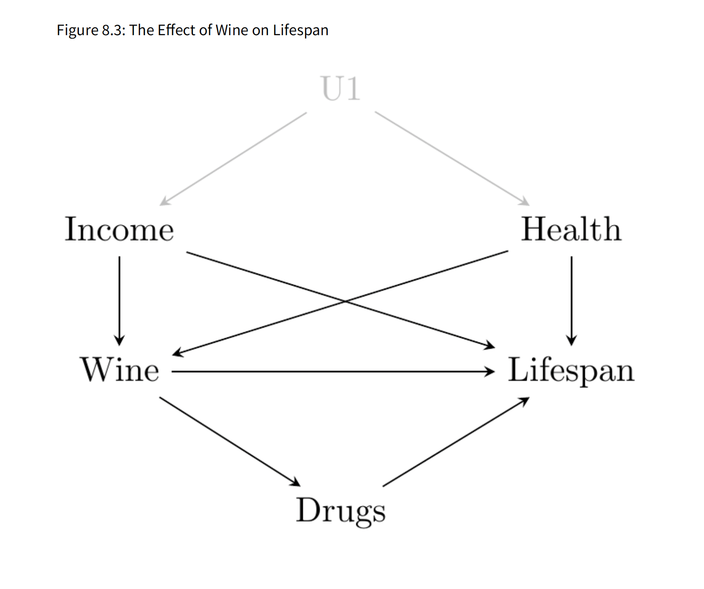
THE EFFECT, CH. 8
Wine → lifespan and wine → drugs → lifespan are causal paths for the total effect.
Wine ← income → lifespan is a backdoor path. Health creates another.
Adjust for income and health; leave the path through drugs open.
Wine and Lifespan: Which Paths Stay Open?
Question for class: What changes if we adjust for drugs?

Slide 14
DAGS
An adjustment set is a list of variables that, if you control for them, closes every biasing path without closing the causal path you care about.
There can be more than one valid adjustment set — Dagitty finds all of the MINIMAL sufficient ones (the smallest sets that still work).
This isn't magic — it's the same backdoor-path logic from Week 2, just automated for diagrams too complex to check by hand.
Adjustment Sets: What Dagitty Is Actually Computing
Read Dagitty’s suggested adjustment sets as answers for the DAG you drew. Check whether its arrows match your causal assumptions.

Slide 15
Bought a sandwich → ate a sandwich ← received one from the boss.
Buying and receiving a sandwich can be unrelated across the whole office.
Among people who ate one, knowing they did not buy one makes a gift more likely.
THE EFFECT, CH. 8
The Sandwich Example: Conditioning on a Collider
Sample restriction can condition on a collider, even without a regression control.

Slide 16
DAGS
How to Choose the Correct Variables
A practical decision process — ask these questions about each candidate variable, in order:
1
Was it measured BEFORE treatment?
If measured later, examine its causal role. Timing alone does not classify the variable.
2
Does it plausibly cause BOTH treatment and outcome?
If yes — it's a confounder. Include it.
3
Is it caused by treatment itself?
For a total effect, leave that path open. Studying mediation requires a different question and more assumptions.
4
Do two arrows meet at this variable on a path?
If so, conditioning on it can open that path, including through sample selection.
5
Still unsure?
Draw the DAG. If you can't confidently place an arrow, that's a sign you need more domain knowledge, not more data.

Slide 17
DAGS
Using Dagitty.net: The Interface
Add a new variable
Double-click empty canvas space (or press “n”)
Rename a variable
Hover over it, press “r”
Add an arrow
Double-click the source node, then double-click the target node
Set exposure / outcome
Hover over the node, press “e” (exposure) or “o” (outcome)
Mark a variable unobserved
Hover over it, press “u”
Delete a variable
Hover over it, press “d” or Delete
See the adjustment set
Automatic, once exposure + outcome are set — shown in the sidebar
No account, no install — just dagitty.net, and everything above works with mouse + keyboard together.

Slide 18
DAGS
Worked Example: Tonight's Lab DAG
We'll build this together, live, in Dagitty:
Confounder
Treatment
Outcome
Collider
Set Treatment as exposure, Outcome as outcome. Check the sidebar's adjustment set — it should recommend Confounder, and explicitly NOT recommend Collider.

Slide 19
PART 3
Potential Outcomes

Slide 20
POTENTIAL OUTCOMES
The Fundamental Problem, Formalized
For any single person, we can never observe both:
Y(1) — what happens WITH treatment
Y(0) — what happens WITHOUT treatment
This is potential outcomes notation — Y(1) and Y(0) are the two versions of the outcome for the SAME person, under each treatment condition. Only one is ever realized; the other is the counterfactual.
Individual treatment effect: τᵢ = Yᵢ(1) − Yᵢ(0) — unobservable for any one person, but the target quantity averages are built from.

Slide 21
POTENTIAL OUTCOMES
The Switching Equation, and SUTVA
The observed outcome connects to the two potential outcomes by:
Y = D·Y(1) + (1−D)·Y(0)
D = 1 if treated, D = 0 if not — the “switch” that picks which potential outcome we actually observe.
SUTVA (Stable Unit Treatment Value Assumption) — required for ALL of this to make sense:
No interference: my potential outcomes don't depend on YOUR treatment status.
No hidden variations of treatment: “treated” means the same thing for everyone — there's only one Y(1), not many versions of it.
SUTVA violation example: vaccinating your neighbor changes YOUR risk of infection too — that's interference, and it breaks the simple potential-outcomes framework.

Slide 22
POTENTIAL OUTCOMES
Defining the ATE
The Average Treatment Effect: the expected difference between Y(1) and Y(0), averaged across the WHOLE population of interest.
You can never compute it directly (nobody has both outcomes) — but you can estimate it, if you have a credible design.
This is the quantity a well-run RCT estimates directly, since random assignment makes treated and untreated groups comparable on average.
ATE = E[Y(1) − Y(0)]

Slide 23
POTENTIAL OUTCOMES
ATT and ATU: Why They Differ from ATE
ATE
E[Y(1) − Y(0)]
Everyone in the population
ATT
E[Y(1) − Y(0) | X=1]
Only those who WERE treated
ATU
E[Y(1) − Y(0) | X=0]
Only those who were NOT treated
These three numbers CAN be different — whether they are depends on whether the people who select into treatment differ systematically from those who don't.

Slide 24
In Heiss’s synthetic data, income and health influence net use and malaria risk.
True effects: ATT = −16.29; ATE = −15.02; ATU = −13.63 (risk points).
Numerically ATT < ATE < ATU. The more negative ATT is the larger protective reduction.
POTENTIAL OUTCOMES
A Concrete Example: Bed Nets and Malaria
Policy question: current net users benefit more on average than current nonusers would. Effects may differ as a program expands.

Slide 25
POTENTIAL OUTCOMES
Estimating ATE, ATT, ATU from Real Data
w_ate <- weightit(net ~ income + health, data = nets, method = "glm", estimand = "ATE")
model_ate <- lm(malaria_risk ~ net, data = nets, weights = w_ate$weights)
Use avg_comparisons(model_ate, variables = "net") for the weighted net contrast.
Refit the weights and model for ATT; use estimand = "ATC" in WeightIt for ATU.
The Lab 2 ATE estimate was −14.7, close to the true ATE of −15.02.
Weighting targets the chosen population. This weighted comparison is distinct from g-computation.

Slide 26
THIS WEEK
Readings: Key Takeaways
Huntington-Klein, The Effect, Chapters 7–8
Start with treatment and outcome; simplify a mediator on the diagram if its mechanism is outside the question.
For a total effect, close open backdoor paths. Conditioning on a collider can open a path that was closed.
The Effect, Chapter 10; Heiss, “Demystifying causal inference estimands”
Chapter 10 distinguishes ATE, ATT, and effects among the untreated; Heiss illustrates all three with synthetic net data.
The target population matters: an effect among current users need not equal the effect among future users.

Slide 27
LOOKING AHEAD
Difference-in-differences (Weeks 8–9) estimates an ATT.
Regression discontinuity and instrumental variables (Week 12) estimate a LATE — a local average treatment effect, for a specific subgroup defined by the design itself.
Every method from here forward answers a SPECIFIC version of the causal question — part of evaluating any design is asking which estimand it actually gives you, and whether that's the one your research question needs.
Why This Matters for the Rest of the Semester

Slide 28
Questions?
Next week: Randomized Controlled Trials.

